Slide 1
Scrabble User Rating Model
AIML301 Project
Nayan Ranjan Das
Manya Tuli
Shivansh Uppal
Garima Sharma

Slide 2
Problem Statement
The dataset includes information about ~73,000 Scrabble games played by three bots on Woogles.io: BetterBot (beginner), STEEBot (intermediate), and HastyBot (advanced).
The games are between the bots and their opponents who are regular registered users. You are using metadata about the games as well as turns in each game (i.e., players' racks and where and what they played, AKA gameplay) to predict the rating of the human opponents in the test set (test.csv).
We have trained our model on gameplay data from one set of human opponents to make predictions about a different set of human opponents in the test set.
There is metadata for each game (games.csv), gameplay data about turns played by each player in each game (turns.csv), and final scores and ratings from BEFORE a given game was played for each player in each game (train.csv and test.csv).

Slide 3
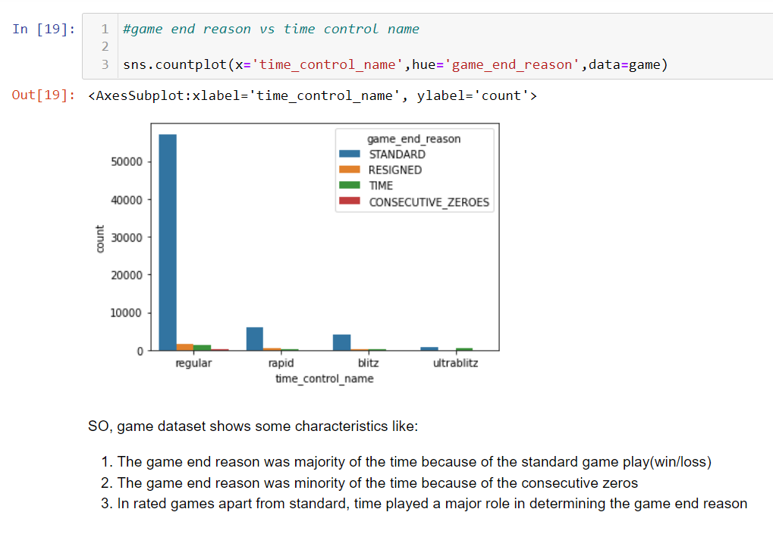
Exploratory Data Analysis

Slide 4
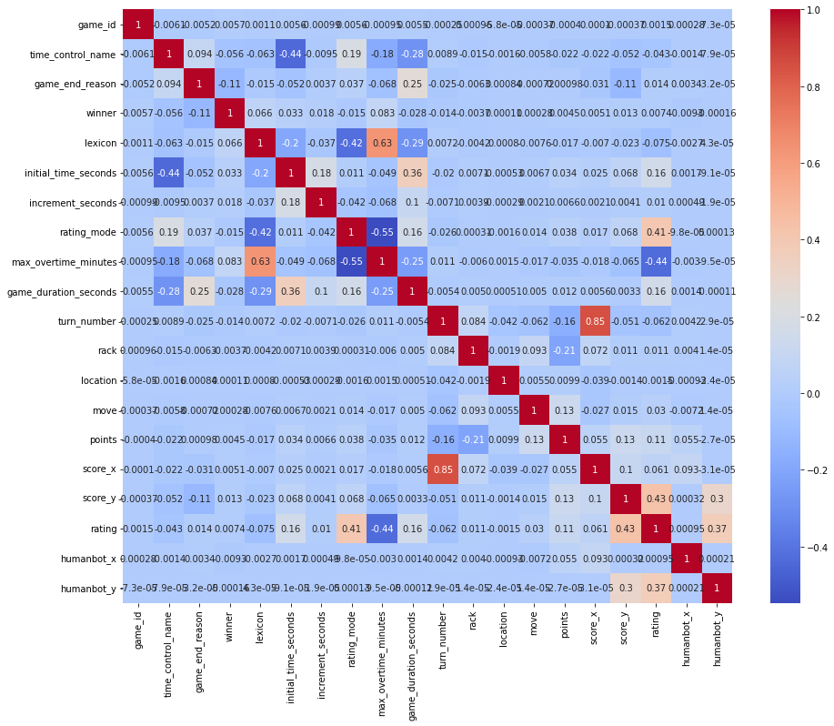
Exploratory Data Analysis

Slide 5
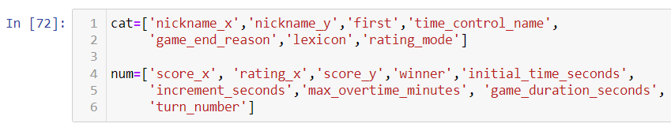
Feature Selection

Slide 6
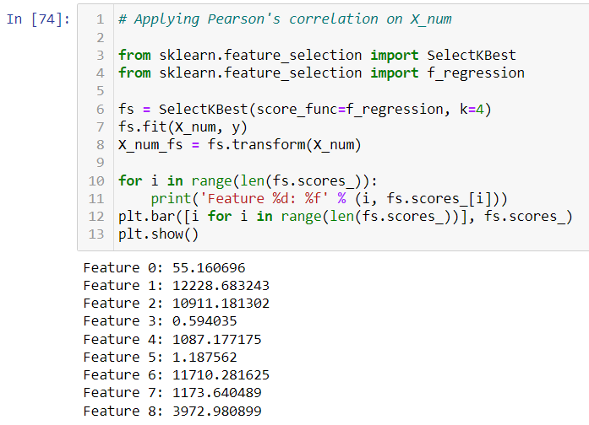
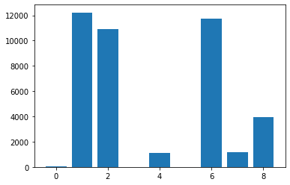
Feature Selection

Slide 7
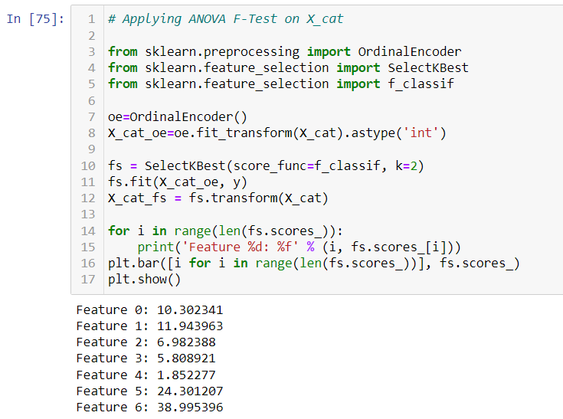
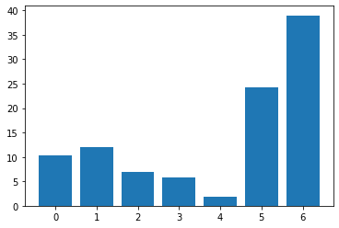
Feature Selection

Slide 8
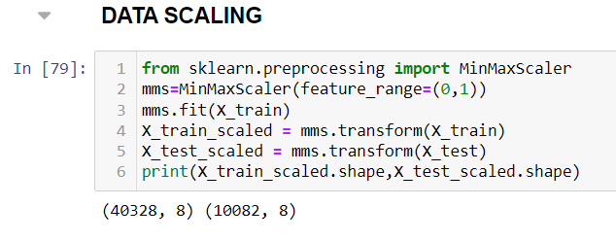
Feature Selection

Slide 9
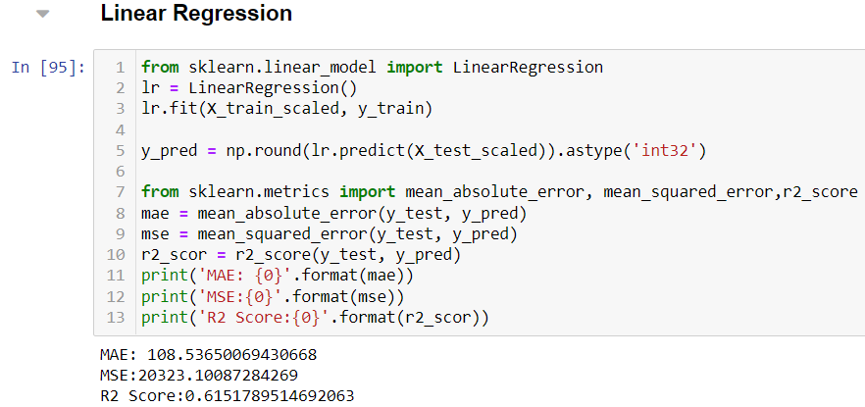
ML Algorithms

Slide 10
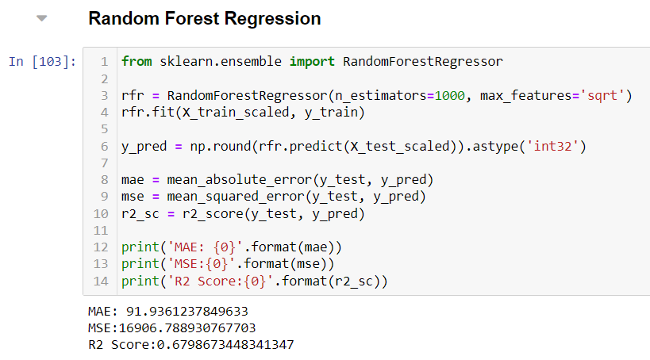
ML Algorithms

Slide 11
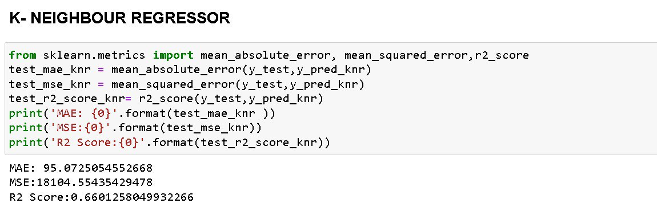
ML Algorithms

Slide 12
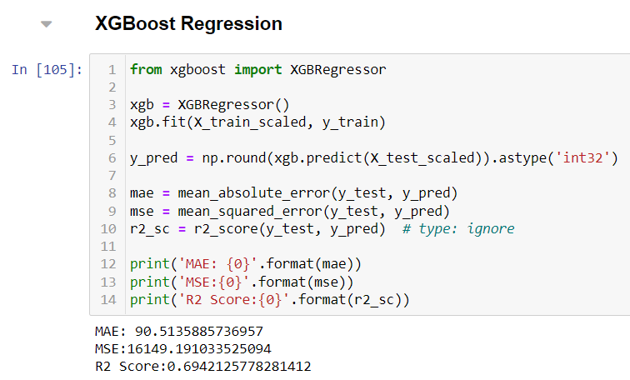
ML Algorithms

Slide 13
Thank You

